Slide 1
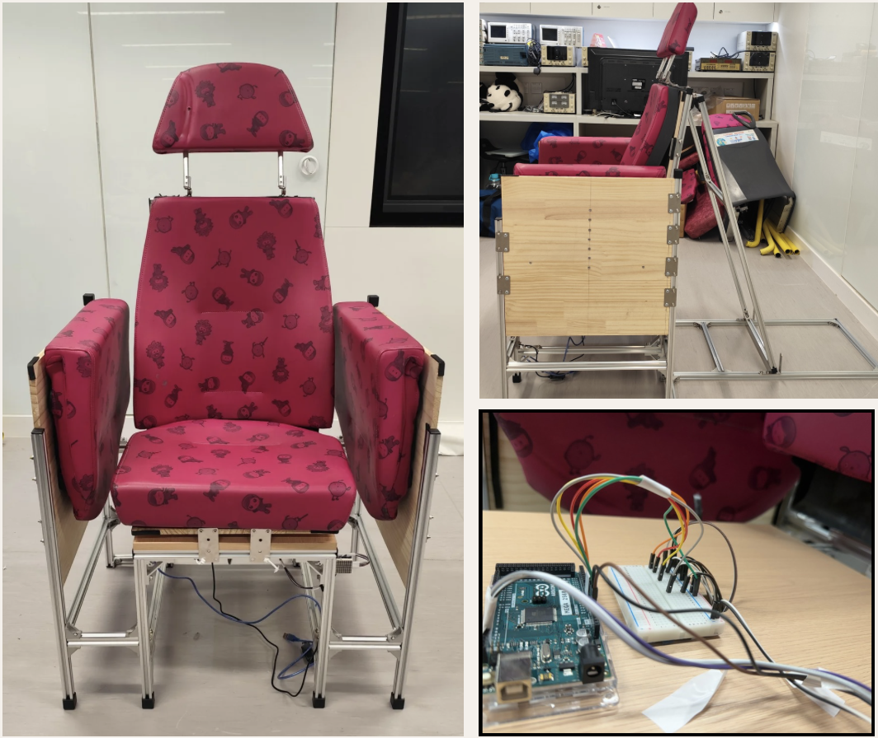


CARNEGIE MELLON BME FORUM 2026
From Bus Seats to Elderly Care: A low-cost Recycled Chair with COP Based Posture Feedback
KAYESH Kashpia¹, PESHAYA Alisa¹, SAHA Riti Proma¹, SHEIKH Aimen Qaiser¹
LAU Hin Chung², CHIU Armstrong T. S.²
¹ Department of Biomedical Engineering, The Hong Kong Polytechnic University
Background
Purpose
Course project for BME31147 (BME Innovation for the Community), developed with the Hong Kong Society for the Blind and Kowloon Motor Bus (KMB).
Repurposes durable, upcycled transport-seating materials into a modular aluminum chair frame, guided by occupational therapy expertise.
Targets safe sit-to-stand movement, pressure-care awareness, and fall prevention for visually impaired elderly users.
To design and prototype an upcycled, IoT-enabled smart chair that helps visually impaired elderly individuals sit, stand, and reposition safely, comfortably, and independently.
1

Slide 2
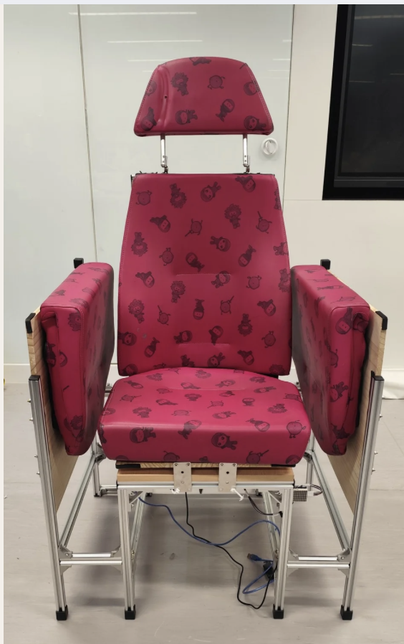
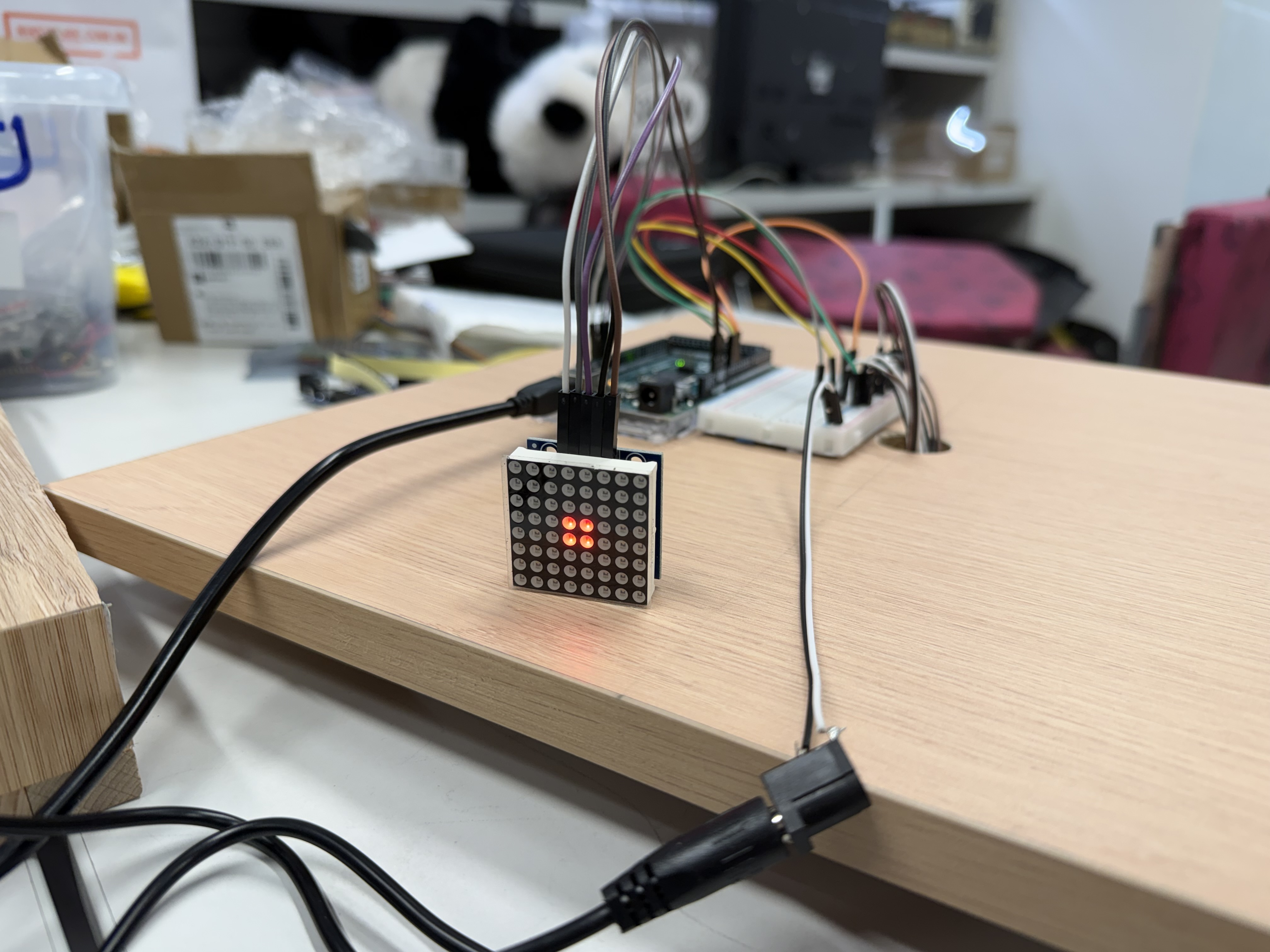


Methods
Design shaped by a structured end-user needs assessment — prioritising stability, durability, comfort, and adjustability — then developed across two integrated tracks:
Hardware
Software
Upcycled Structural Design: partnered with KMB to repurpose transport-seating materials into a sturdy, modular aluminum frame with an anti-topple base.
Ergonomic Adjustability: adjustable armrests and multi-positional backrest incline provide user-centric support.
IoT Sensor Integration: load cells and strain gauges embedded in the seat monitor presence, and real-time Centre of Pressure (COP) shifts.
Real-Time Feedback: sensor data feeds an LED matrix display, giving actionable cues for posture, pressure-care, and fall prevention.
END-USER NEEDS:
Lightweight
Stable
User-Friendly
Durable
Comfortable
Adjustable Incline
Sensor-Integrated
Seatbelt-Secured
Upcycled Smart Seating System for Elderly People
2

Slide 3


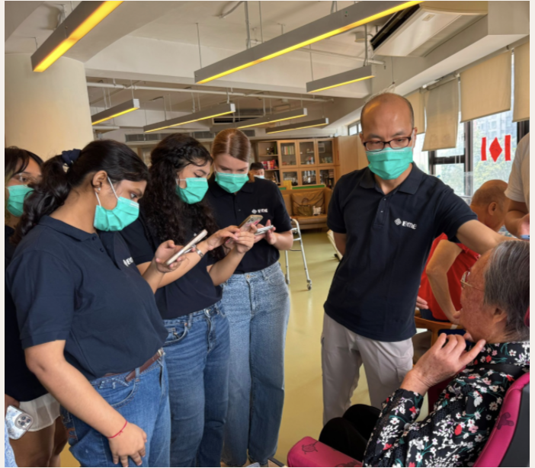

Results & Conclusion
Strengths
Improvements
Stable, safe structure
Strong, durable build that's easy to clean
Adjustable backrest adds flexibility
Provides Real time Centre of Pressure Shift
Sizing: Chair too wide and seat too tall for the average user.
Comfort: Firmer cushioning with limited lower-back support.
Practicality: Headrest stability and overall weight for moving around.
Conclusion
[User Testing Photo]
This prototype delivers a working, upcycled smart-seating system pairing sensor-based posture and pressure monitoring with real-time LED feedback for fall prevention. Testing with real users confirmed strong stability and durability, and pointed to clear next steps in sizing, comfort, and support.
Upcycled Smart Seating System for Elderly People
3

